Slide 1
Probabilistic Programming
Marius Popescu
popescunmarius@gmail.com
2025 - 2026

Slide 2
Introduction

Slide 3
What is Probabilistic Programming
Probabilistic programming languages aim to unify general purpose programming with probabilistic modeling; literally, users specify a probabilistic model in its entirety (e.g., by writing code that generates a sample from the joint distribution) and inference follows automatically given the specification
http://www.probabilistic-programming.org
Probabilistic programming is about performing Bayesian inference using the tools of computer science: programming language for model denotation and statistical inference algorithms for computing the conditional distribution of program inputs that could have given rise to the observed program output
A programming paradigm that provides a language based on random variables and
stochastic control flow to construct a broad class of probabilistic models

Slide 4
Frequentist Vs Bayesian Approaches in Statistics
Frequentist
Bayesian
Assume that probability is the long-run frequency of events
The probability of plane accidents under a frequentist philosophy is interpreted as the long-term frequency of plane accidents.
How to assign probabilities to outcomes of presidential elections? The election itself only happens once!
Interpret a probability as measure of belief, or confidence, of an event occurring. Simply, a probability is a summary of an opinion. An individual who assigns a belief of 0 to an event has no confidence that the event will occur; conversely, assigning a belief of 1 implies that the individual is absolutely certain of an event occurring.
This definition agrees with the probability of a plane accident example, for having observed the frequency of plane accidents, an individual's belief should be equal to that frequency, excluding any outside information.
Similarly, under this definition of probability being equal to beliefs, it is meaningful to speak about probabilities (beliefs) of presidential election outcomes: how confident are you candidate A will win?

Slide 5
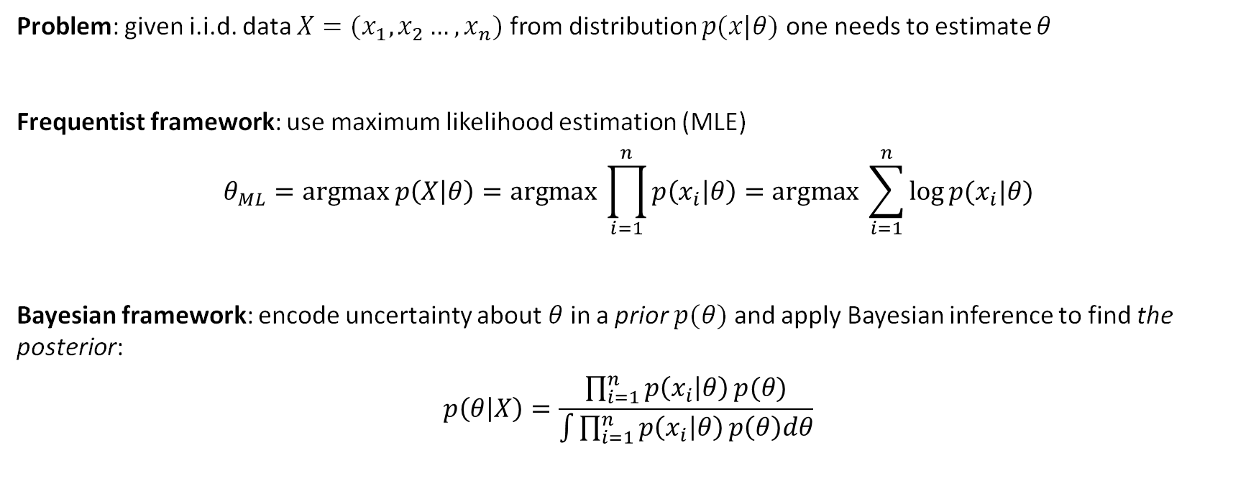
(Bayesian) Probabilistic Modeling
Problem: given i.i.d. data $X=(x_{1},x_{2}…,x_{n})$ from distribution $p(x|θ)$ one needs to estimate $θ$
Frequentist framework: use maximum likelihood estimation (MLE)
$$θ_{ML}=\text{argmax} p\left(X | θ\right)=\text{argmax} \prod_{i=1}^{n}{p\left(x_{i} | θ\right)=\text{argmax} \sum_{i=1}^{n}{\log{p(x_{i}|θ)}}}$$
Bayesian framework: encode uncertainty about$θ$in a prior $p(θ)$ and apply Bayesian inference to find the posterior:
$$p\left(θ | X\right)=\frac{\prod_{i=1}^{n}{p\left(x_{i} | θ\right)}p(θ)}{\int{\prod_{i=1}^{n}{p\left(x_{i} | θ\right)}p\left(θ\right)dθ}}$$

Slide 6
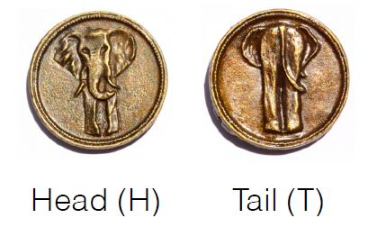
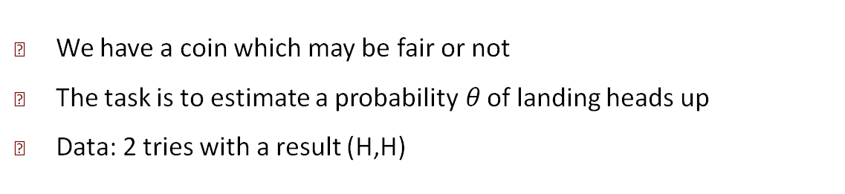
Example: Coin Tossing
We have a coin which may be fair or not
The task is to estimate a probability$θ$ of landing heads up
Data: 2 tries with a result (H,H)

Slide 7

Example: Coin Tossing
We have a coin which may be fair or not
The task is to estimate a probability$θ$ of landing heads up
Data: 2 tries with a result (H,H)
Frequentist framework:
In all experiments the coin
landed heads up
$θ_{ML}$=1
The coin is not fair and
always lands heads up

Slide 8
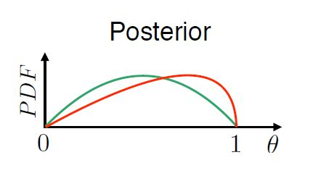
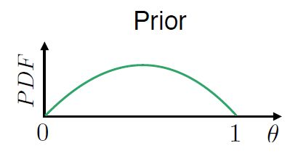
Example: Coin Tossing
We have a coin which may be fair or not
The task is to estimate a probability$θ$ of landing heads up
Data: 2 tries with a result (H,H)
Bayesian framework:

Slide 9
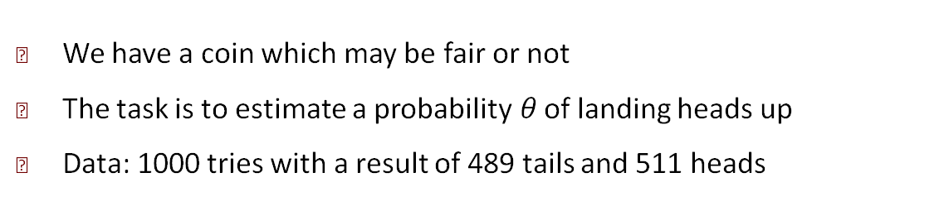
Example: Coin Tossing
We have a coin which may be fair or not
The task is to estimate a probability$θ$ of landing heads up
Data: 1000 tries with a result of 489 tails and 511 heads
Both frameworks:
Sufficient amount of data
matches our expectations
The coin is fair

Slide 10
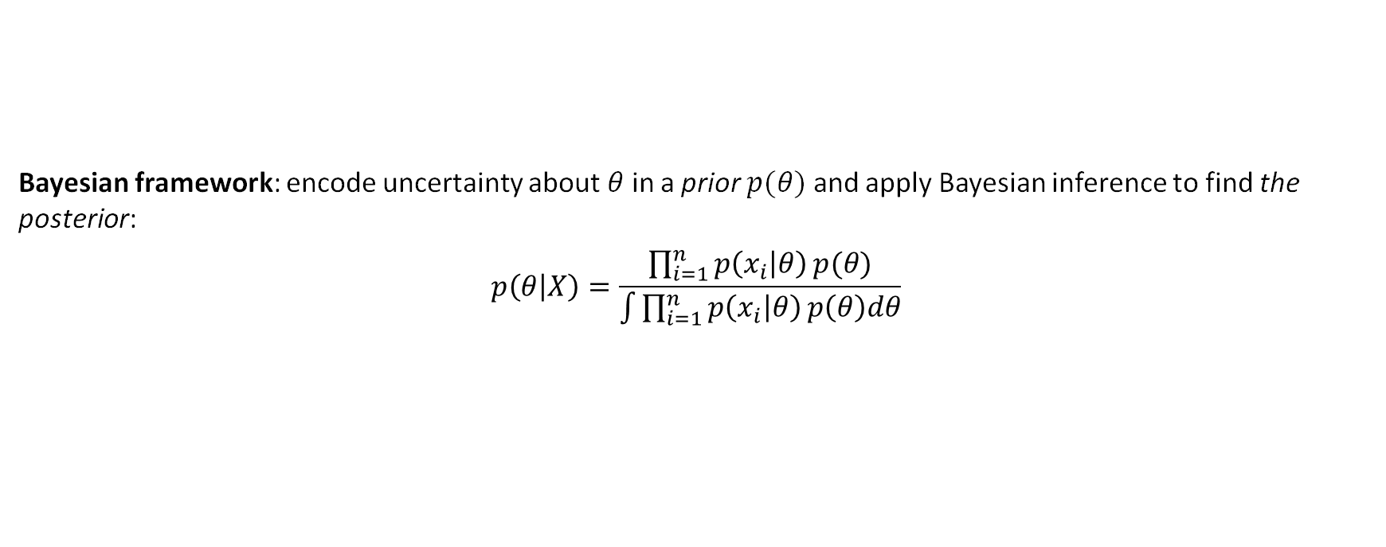
Bayesian Modeling: The Problem
Bayesian framework: encode uncertainty about$θ$in a prior $p(θ)$ and apply Bayesian inference to find the posterior:
$$p\left(θ | X\right)=\frac{\prod_{i=1}^{n}{p\left(x_{i} | θ\right)}p(θ)}{\int{\prod_{i=1}^{n}{p\left(x_{i} | θ\right)}p\left(θ\right)dθ}}$$
May be intractable

Slide 11
What is Probabilistic Programming
Probabilistic programming languages are to the Bayesian or probabilistic machine learning as automated differentiation tools are to the deep learning
The rapid grow of deep learning has been triggered largely by the emergence of programming language tools that automate the tedious and troublesome derivation and calculation of gradients for optimization
Probabilistic programming aims to build and deliver a toolchain that does the same for probabilistic machine learning

Slide 12
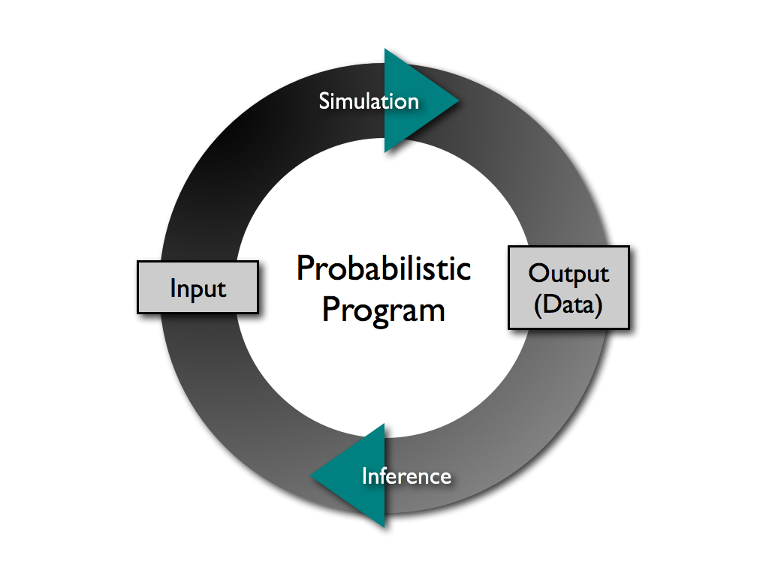
What is Probabilistic Programming

Slide 13
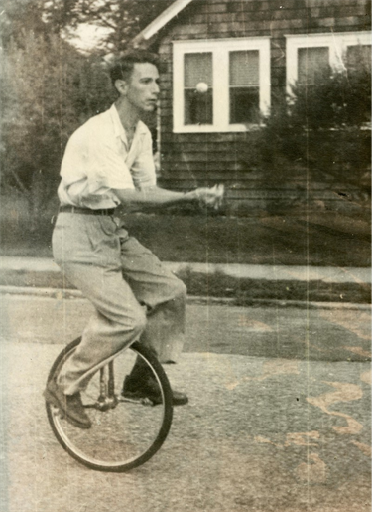
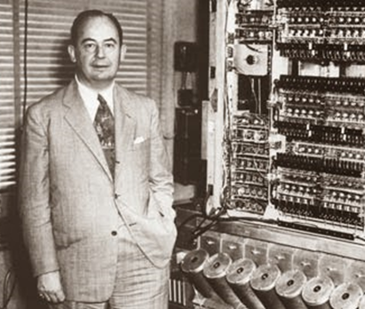
Some History
Von Neumann, J. (1956).
Probabilistic logics and the synthesis of reliable organisms from unreliable components
Shannon, C. E. (1958).
Von Neumann’s contributions to automata theory.

Slide 14
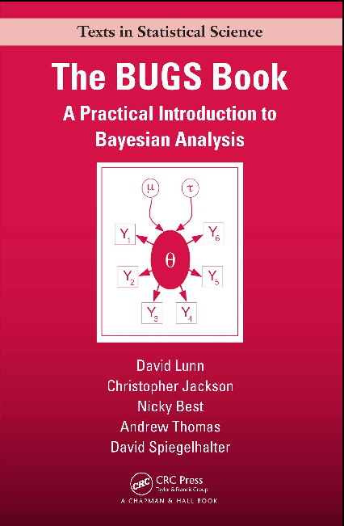
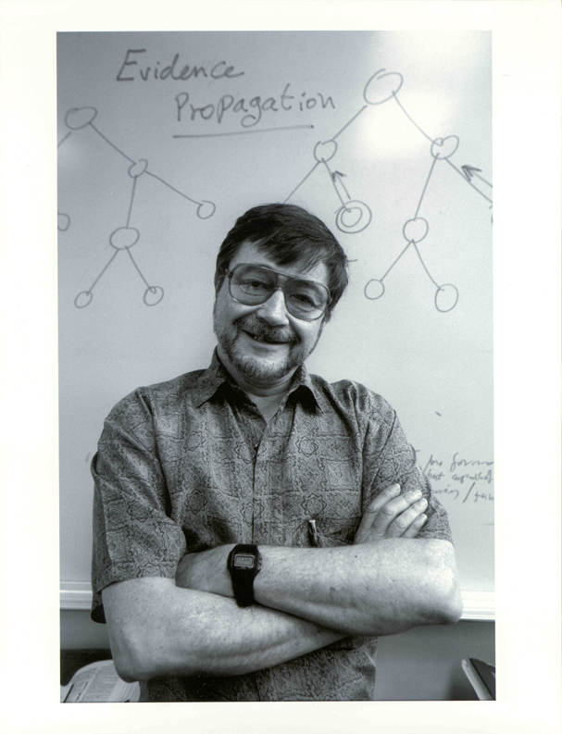
Some History
Pearl, J. (1982).
“Reverend Bayes on inference engines: A distributed hierarchical approach,” Proceedings, AAAI-82
The BUGS (Bayesian inference Using Gibbs Sampling) project is concerned with flexible software for the Bayesian analysis of complex statistical models using Markov chain Monte Carlo (MCMC) methods. The project began in 1989 in the MRC Biostatistics Unit, Cambridge.

Slide 15

Is it useful? Is it hot?
Why to study probabilistic programming?

Slide 16
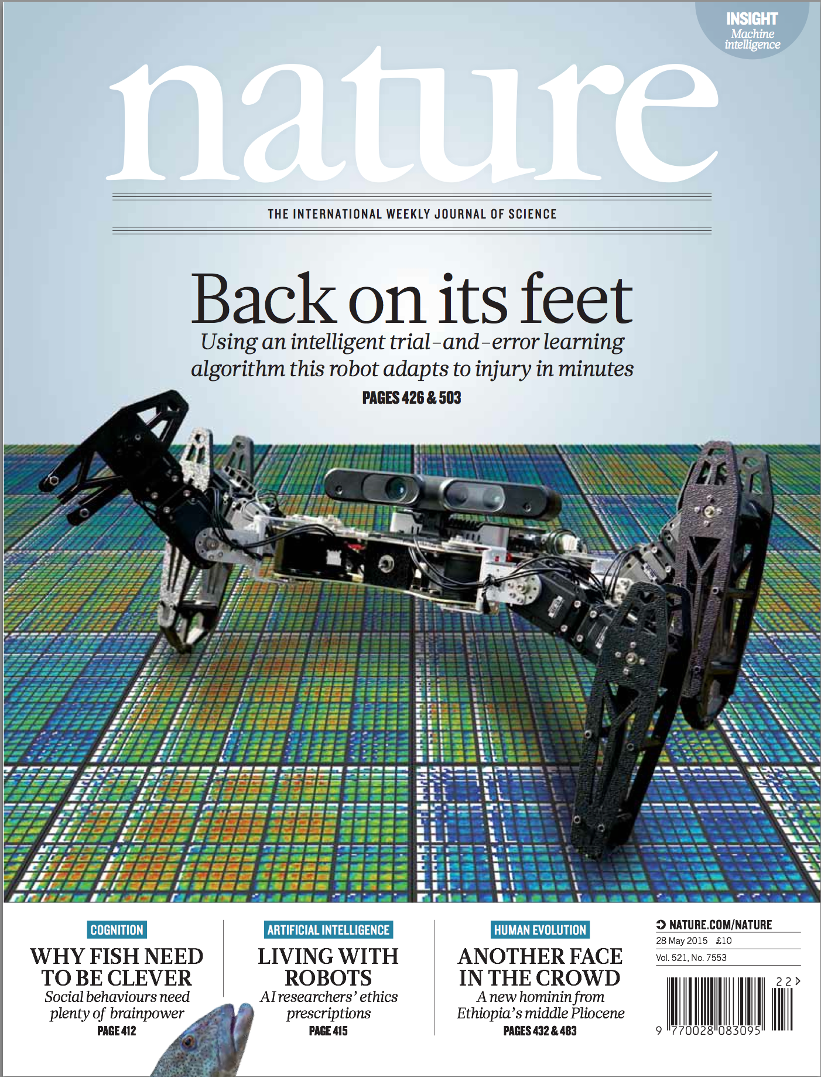

Slide 20
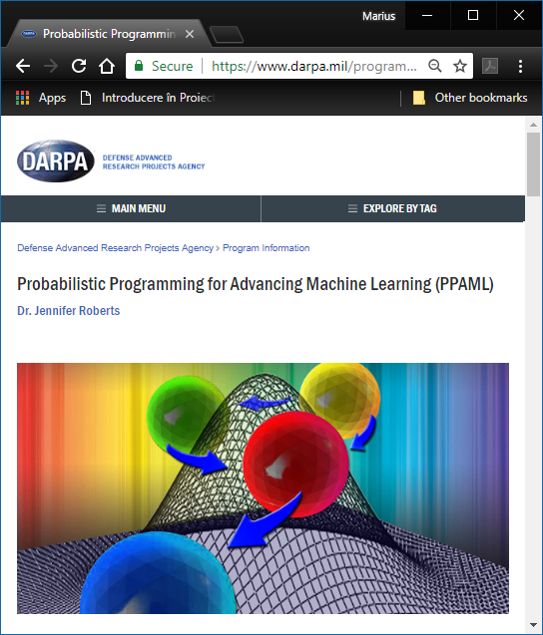
PPAML started in March 2013 and is scheduled to run 46 months, with three phases of activity through 2017

Slide 21
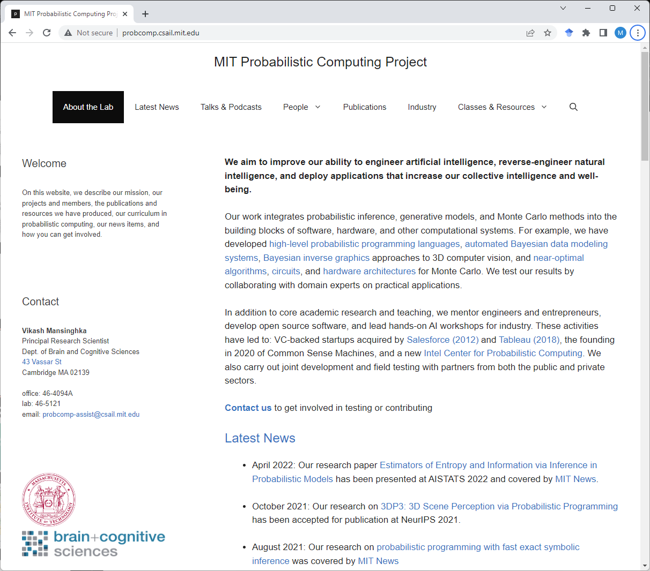

Slide 22
Relation with Deep learning

Slide 23
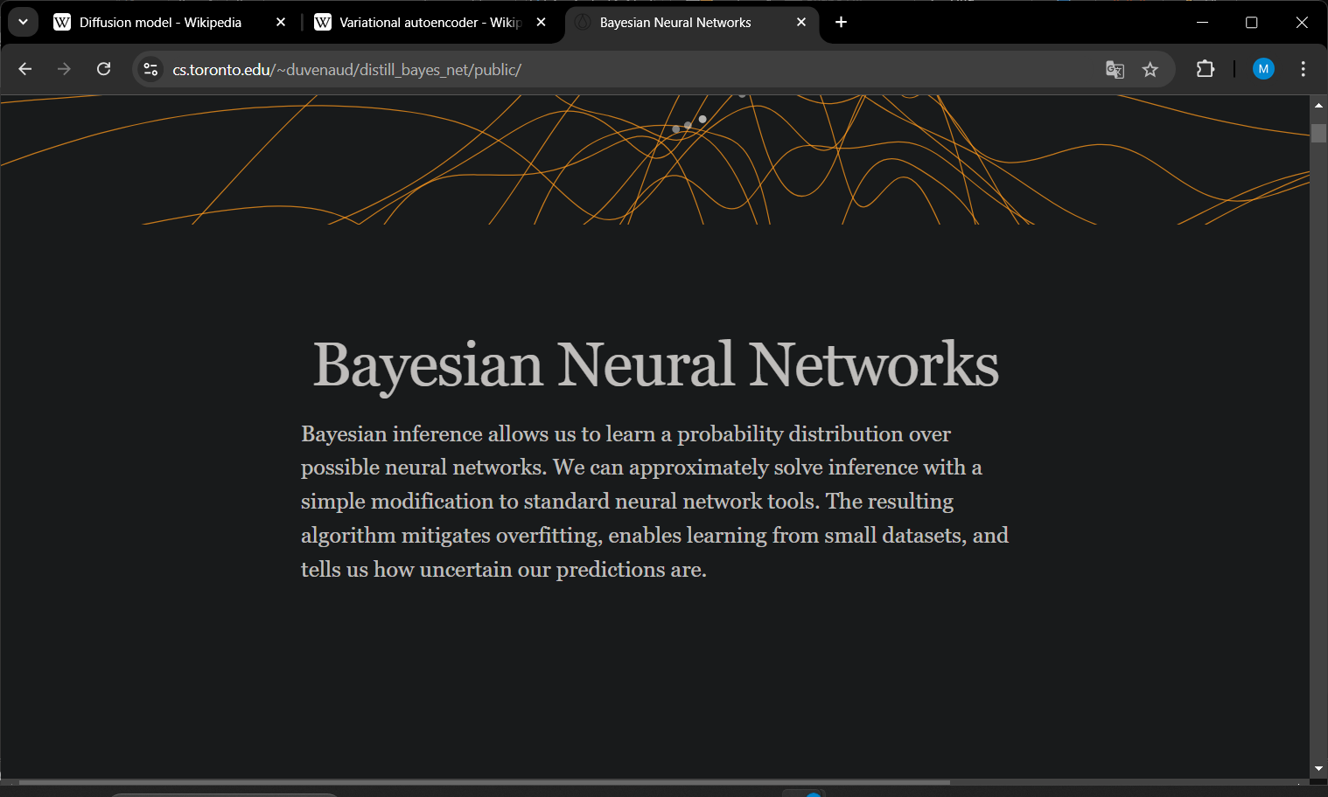

Slide 24
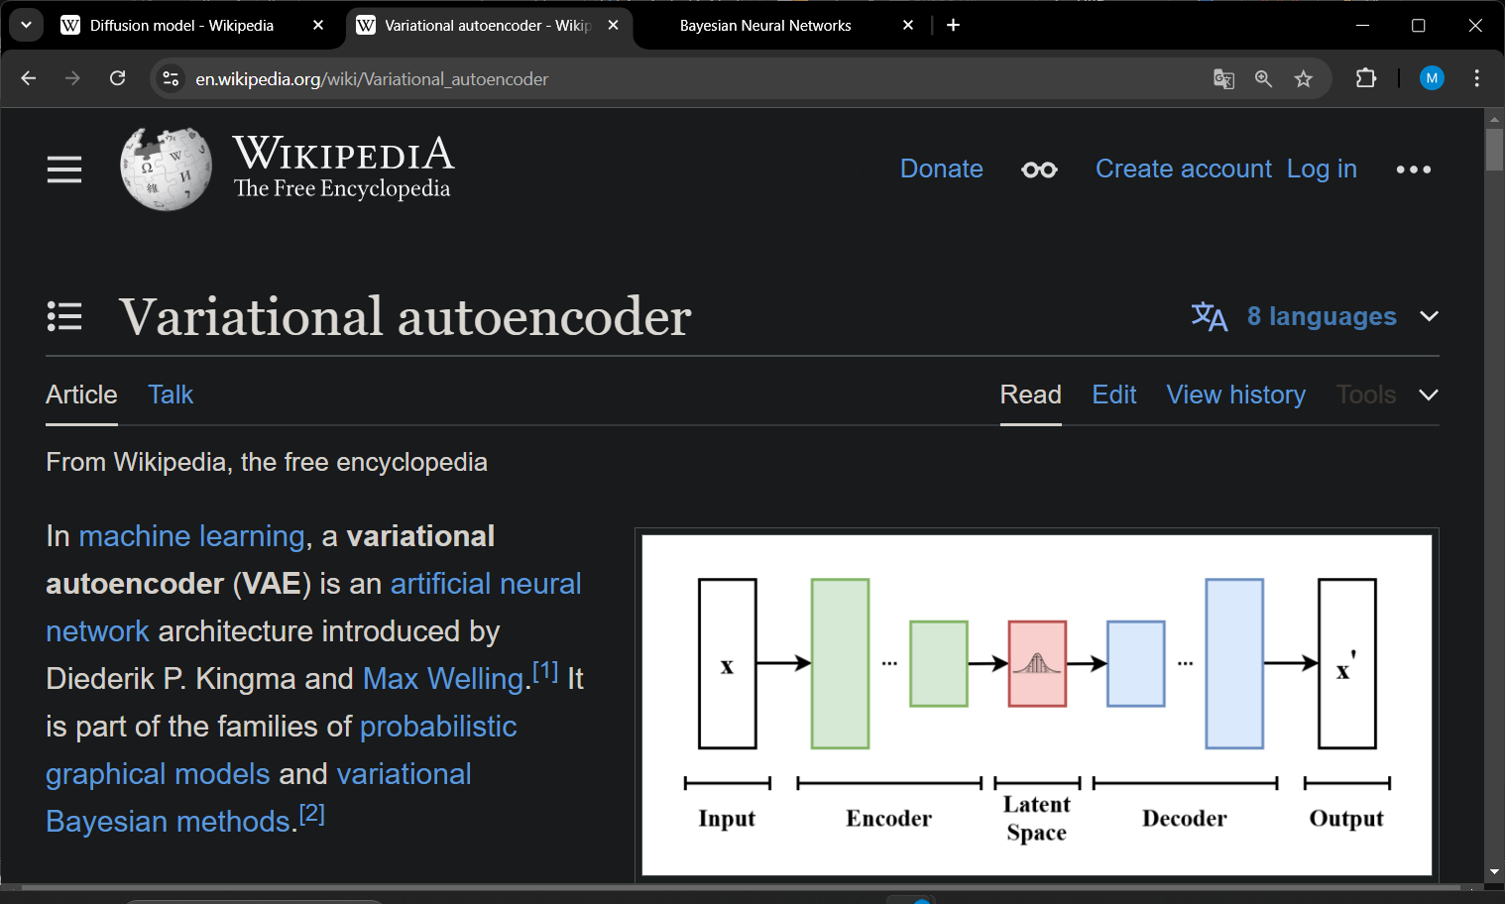

Slide 25
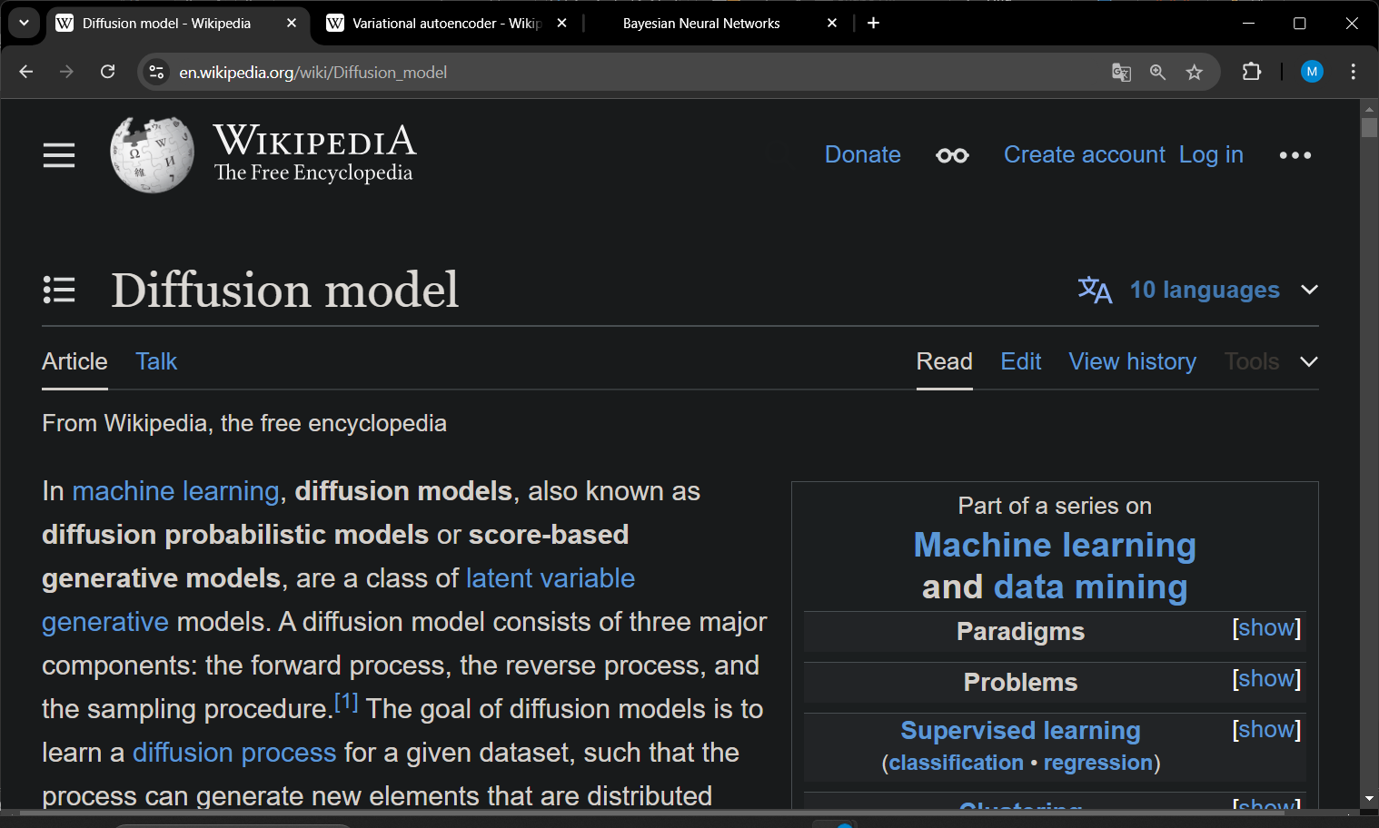

Slide 26
Some Accomplishments

Slide 27


Humans and machines were given an image of a novel character (top) and asked to produce new versions.

Slide 28

Common sense and context affect letter form perception: (i) m vs u and n. (ii) the same line segments are interpreted as N or S depending on occluder positions (iii) perception of the shapes aids the recognition .

Slide 29
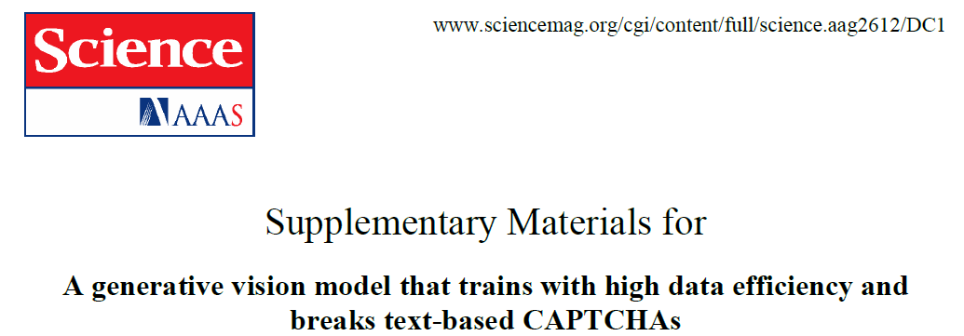
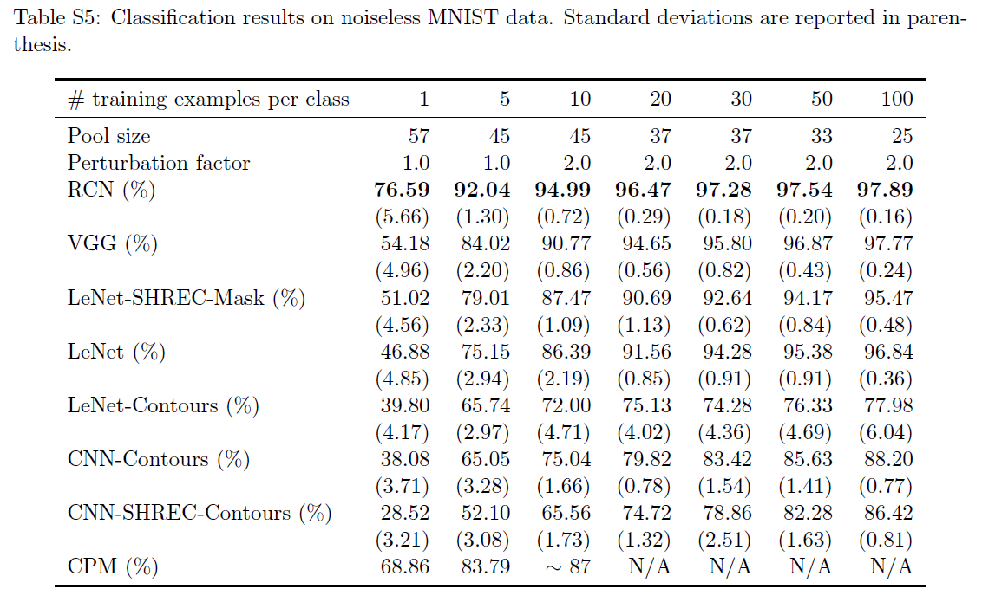

Slide 30
The Course

Slide 31
Course Goal & Objectives
Understanding of the basic concepts and mechanisms of the probabilistic programming
Ability of using a probabilistic programming framework
Using probabilistic programming for building a probabilistic model of a phenomenon, inferring the model parameters given the model and the data, criticizing the model

Slide 32






Tools
PyMC: a probabilistic programming library for Python
(https://www.pymc.io/welcome.html)
Edward: A library for probabilistic modeling, inference, and criticism
(http://edwardlib.org/)
TensorFlow Probability: A library for probabilistic reasoning and statistical analysis
(https://www.tensorflow.org/probability)
PYRO: Deep Universal Probabilistic Programming
(https://pyro.ai/)
Gen: An open-source stack for generative modeling and probabilistic inference
(https://www.gen.dev)

Slide 33
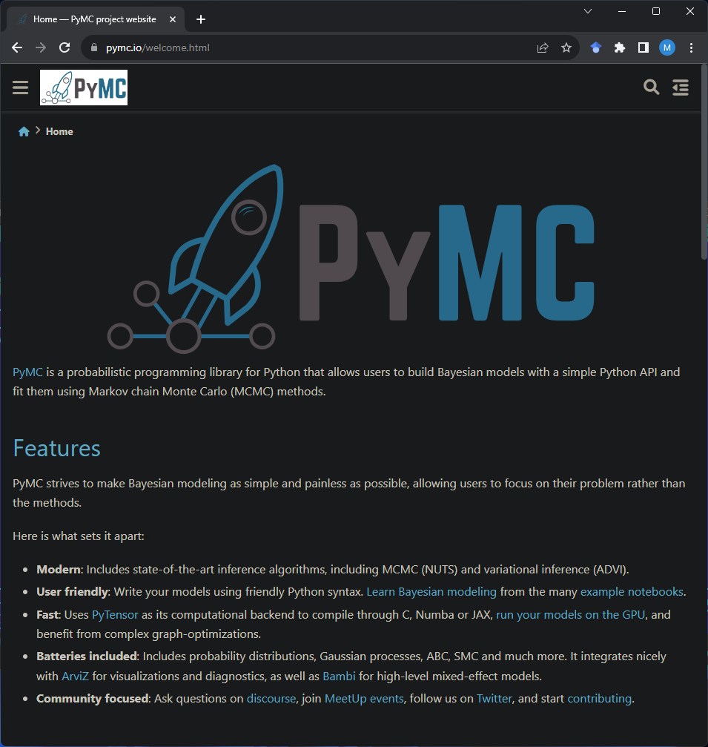

Slide 34
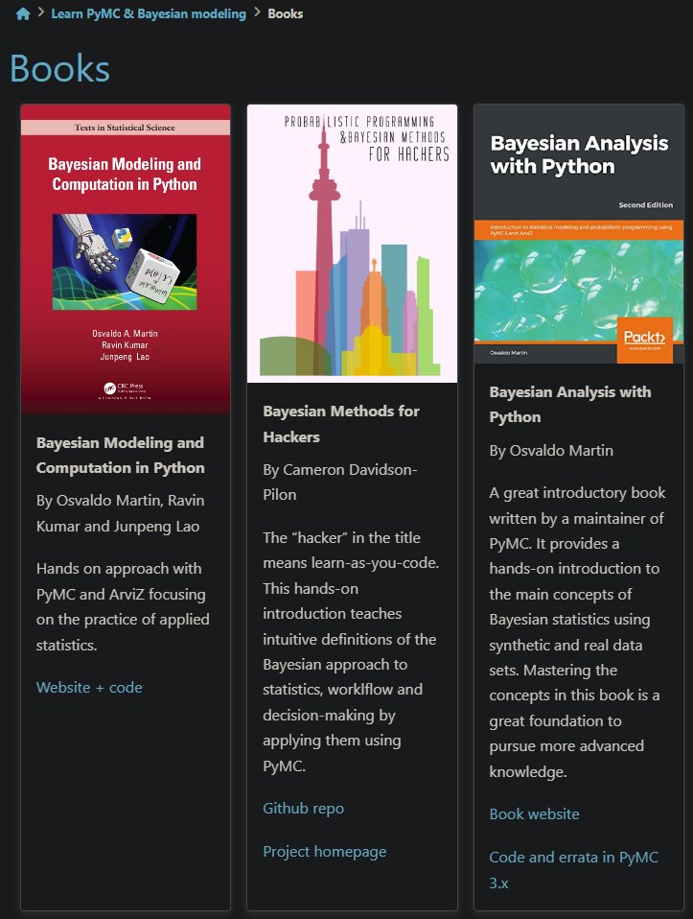
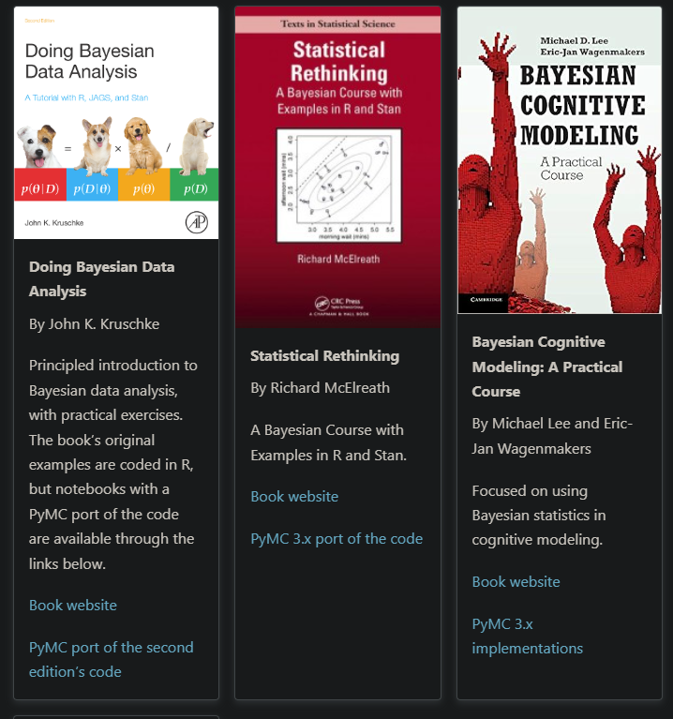

Slide 35
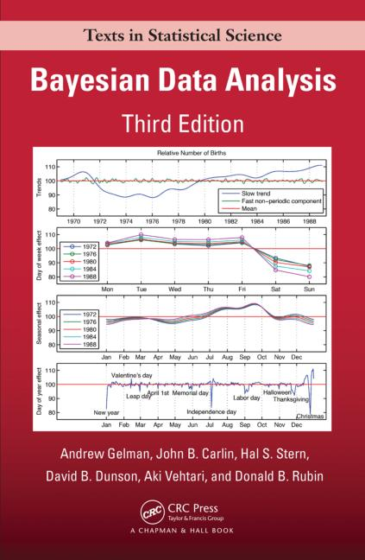
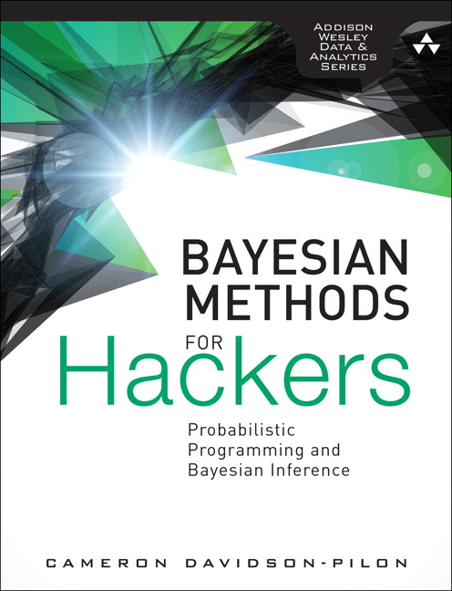
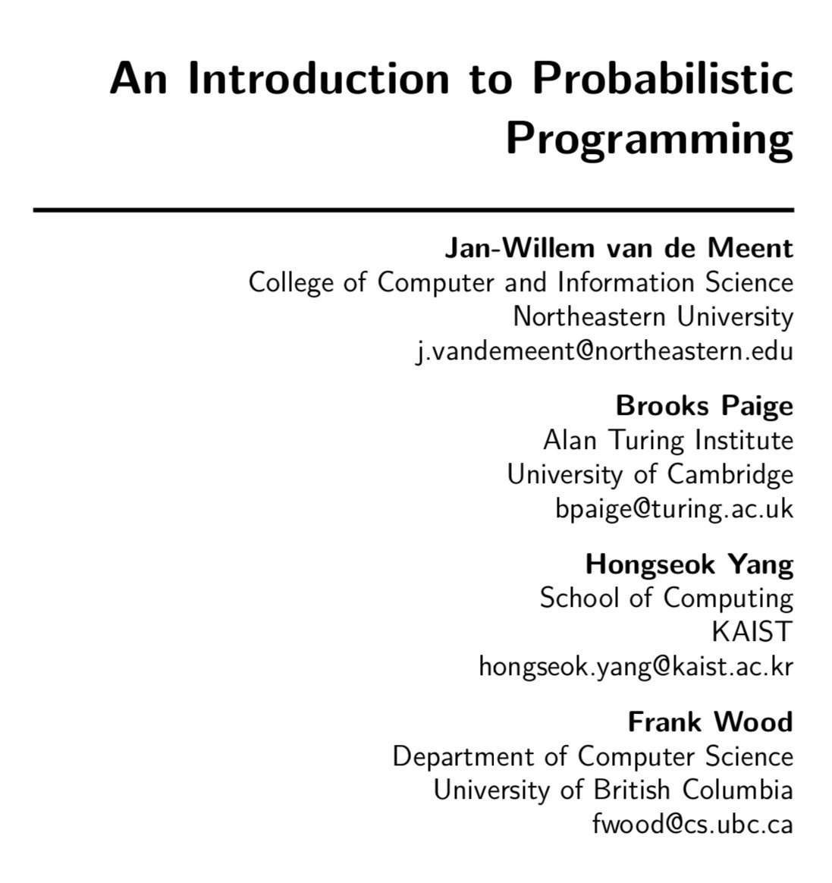
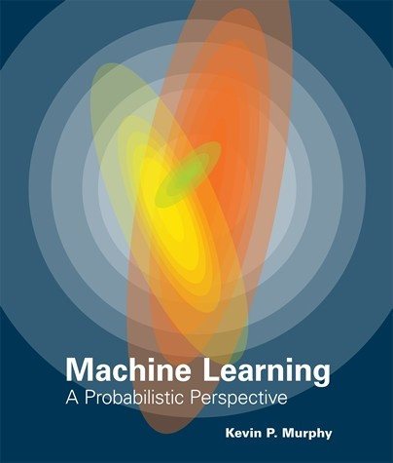
Bibliography
https://arxiv.org/abs/1809.10756
https://github.com/CamDavidsonPilon/Probabilistic-Programming-and-Bayesian-Methods-for-Hackers

Slide 36
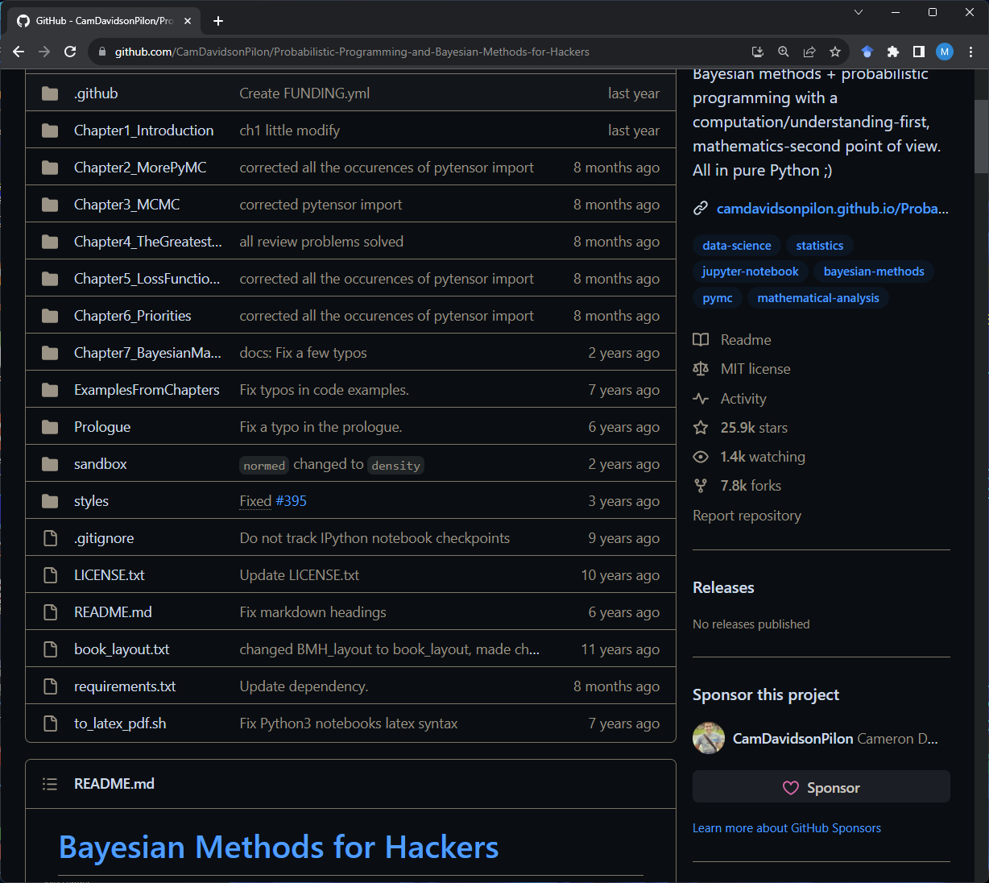

https://github.com/CamDavidsonPilon/Probabilistic-Programming-and-Bayesian-Methods-for-Hackers

Slide 37
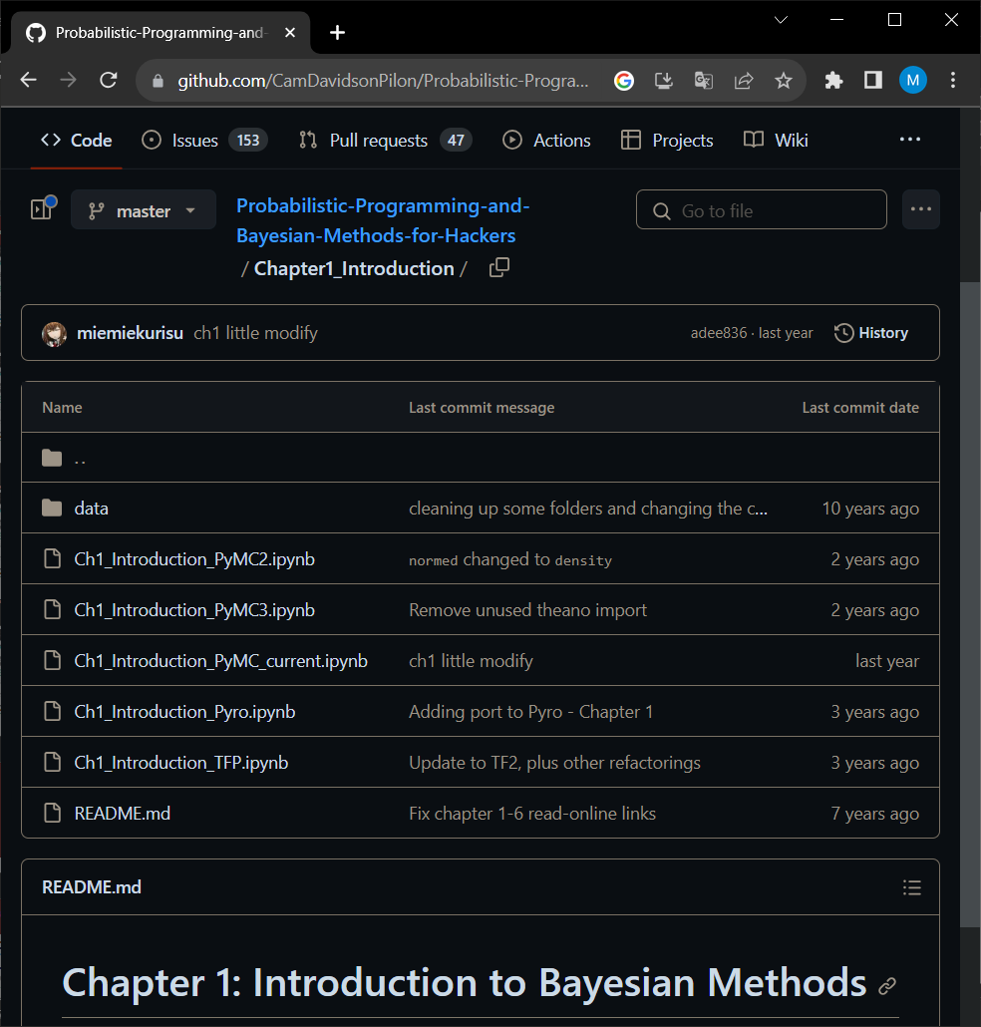
https://github.com/CamDavidsonPilon/Probabilistic-Programming-and-Bayesian-Methods-for-Hackers

Slide 38
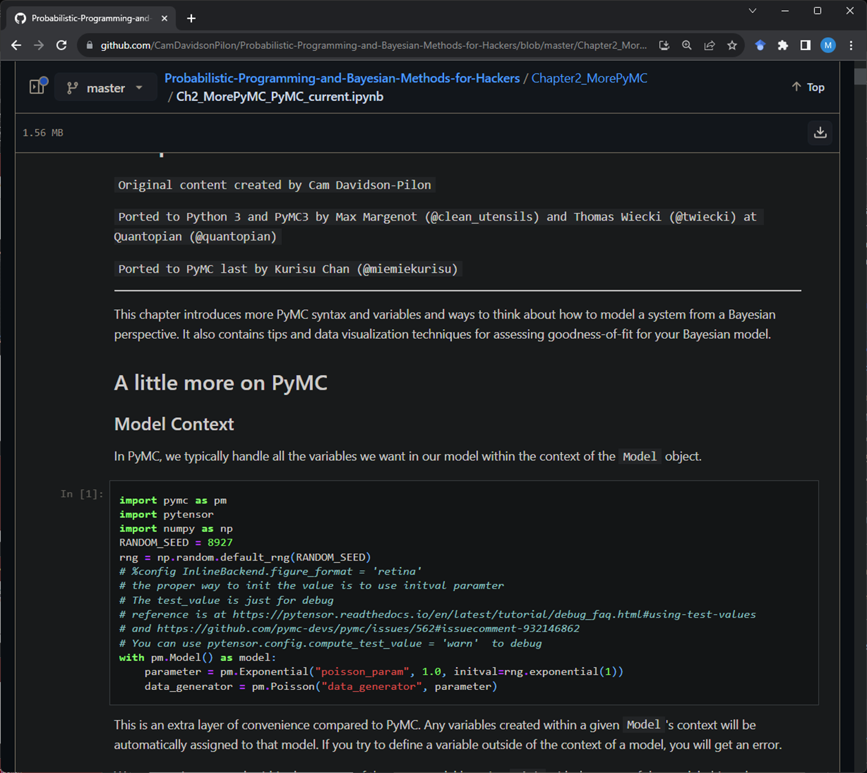
https://github.com/CamDavidsonPilon/Probabilistic-Programming-and-Bayesian-Methods-for-Hackers

Slide 39
“Hello World!”

Slide 40
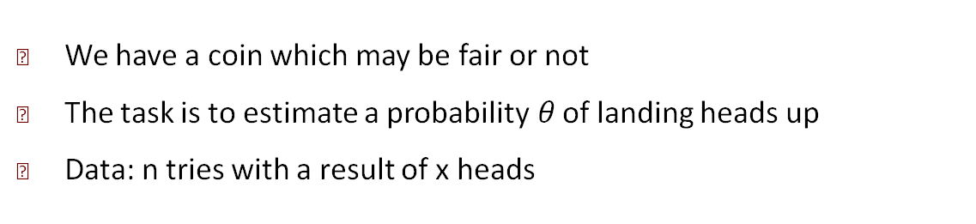
Example: Coin Tossing
We have a coin which may be fair or not
The task is to estimate a probability$θ$ of landing heads up
Data: n tries with a result of x heads
Bayesian framework:

Slide 41
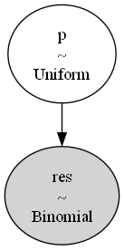
The Model

Slide 42
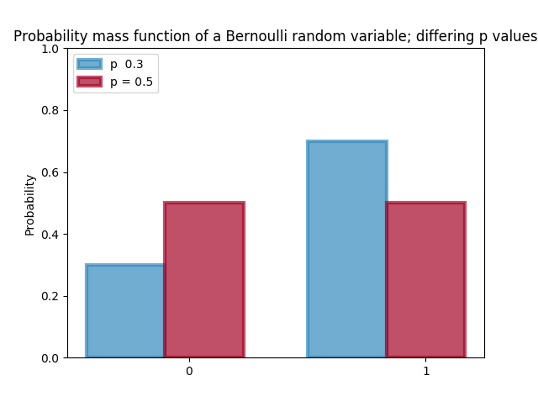
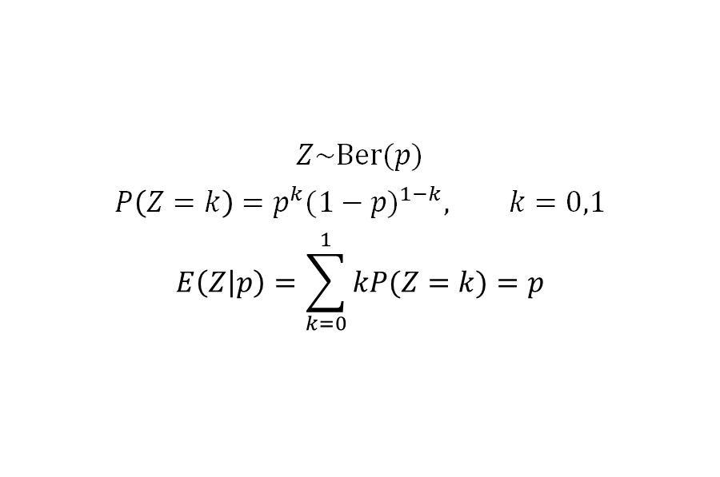
Bernoulli Distribution
$$Z\sim \text{Ber}(p)$$
$$P\left(Z=k\right)=p^{k}{(1−p)}^{1−k}, k=0,1$$
$$E\left(Z | p\right)=\sum_{k=0}^{1}{kP(Z=k)}=p$$
Z = pymc.Bernoulli(“Z”, p)

Slide 43
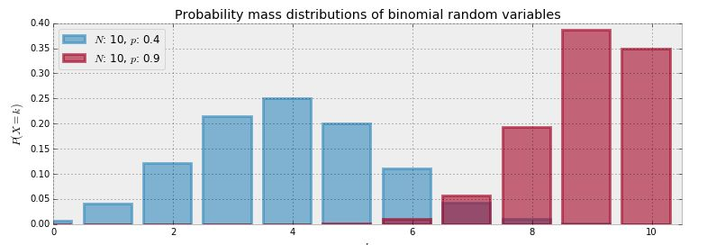
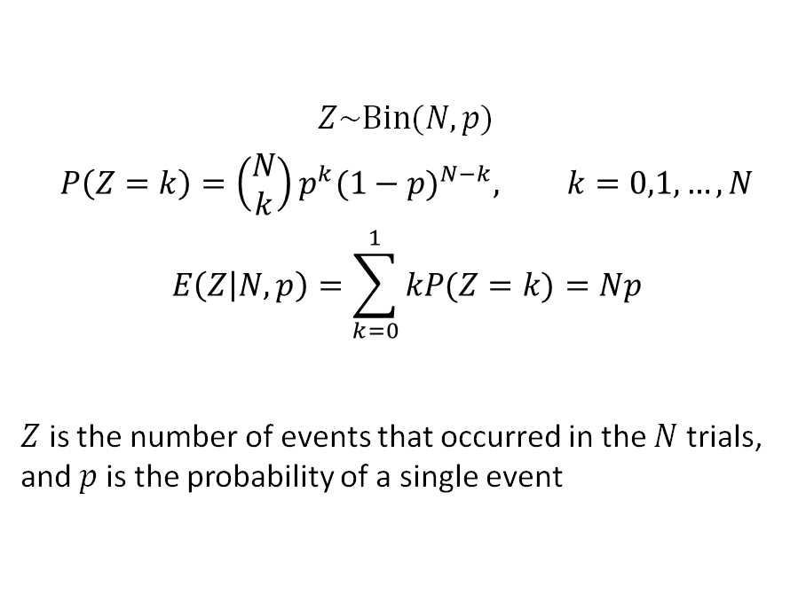
Binomial Distribution
$$Z\sim \text{Bin}(N,p)$$
$$P\left(Z=k\right)={\left(\begin{aligned}N \\ k\end{aligned}\right)p}^{k}{(1−p)}^{N−k}, k=0,1, …, N$$
$$E\left(Z | N,p\right)=\sum_{k=0}^{1}{kP(Z=k)}=Np$$
$Z$ is the number of events that occurred in the $N$ trials, and $p$ is the probability of a single event
Z = pymc.Binomial(“Z”, N, p)

Slide 44
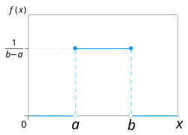
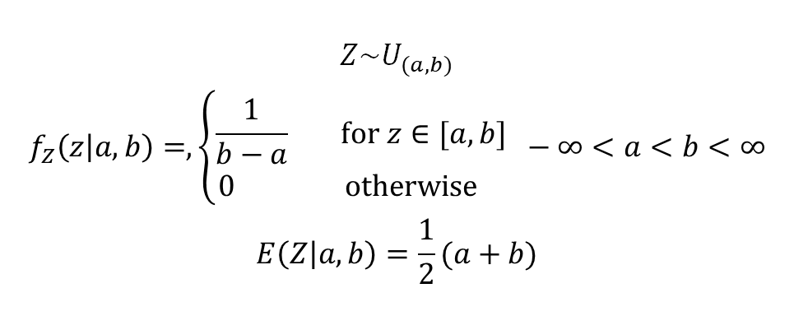
Continuous Uniform Distribution
$$Z\sim U_{(a,b)}$$
$$f_{Z}\left(z | a,b\right)=,\left\{\begin{matrix}\frac{1}{b−a} \text{f}\text{or} z∈[a,b] \\ 0 \text{otherwise} \end{matrix}\right. −∞<a<b<∞$$
$$E\left(Z | a,b\right)=\frac{1}{2}(a+b)$$
Z=pymc.Uniform(“Z”, a, b)

Slide 45
PyMC Solution
import pymc as pm
import graphviz as gv
import numpy as np
import matplotlib.pyplot as plt
true_head_p = 0.7
n = 100
obs = np.random.binomial(n, true_head_p)
with pm.Model() as coin_model:
p = pm.Uniform('p')
res = pm.Binomial('res', n, p, observed=obs)
gv = pm.model_to_graphviz(coin_model)
gv.format = 'png'
gv.render(filename = 'model_graph')
### Mysterious code to be explained in Chapter 3.
with coin_model:
step = pm.Metropolis()
trace = pm.sample(40000, tune=10000, chains=1, step=step, return_inferencedata=False)
p_samples = trace['p']
plt.hist(p_samples, bins = 40)
plt.show()

Slide 46
The Model (Rendered by Graphviz)

Slide 47
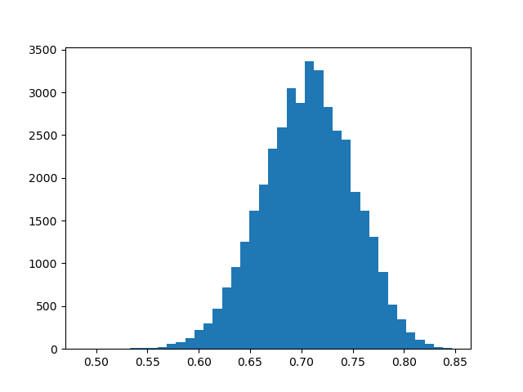
Result: Posterior Distribution of p (n = 100)

Slide 48
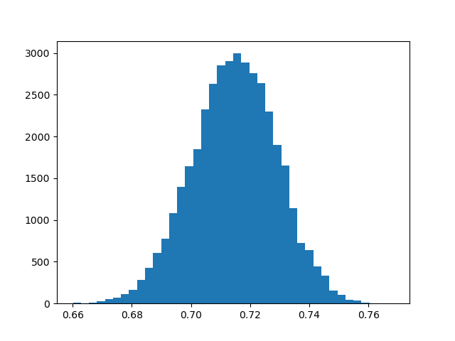
Result: Posterior Distribution of p (n = 1000)

Slide 49
Administrative Details

Slide 50
One Project Assignment
 | Release date | Due date
Project | Week 9 | Week 15
The assignment will be graded from 0 to 10
Collaboration: All students must work individually

Slide 51
Grading
Project – 70%
Exam - 30%

